Slide 1
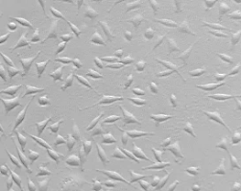
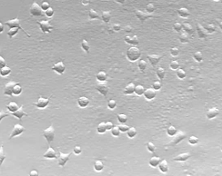
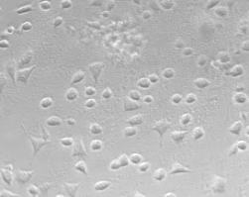
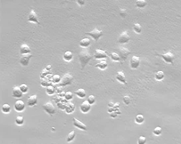
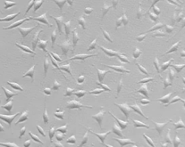
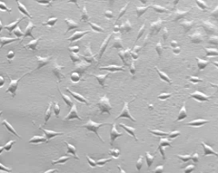
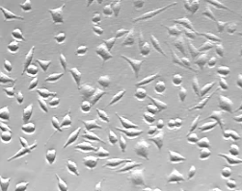
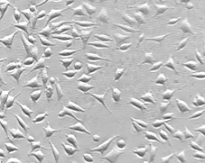
A
10 h
20 h
30 h
40 h
WT
99 %
100 %
98 %
58 %
5SG
99 %
96 %
90 %
88 %

Slide 2

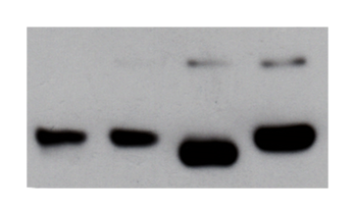
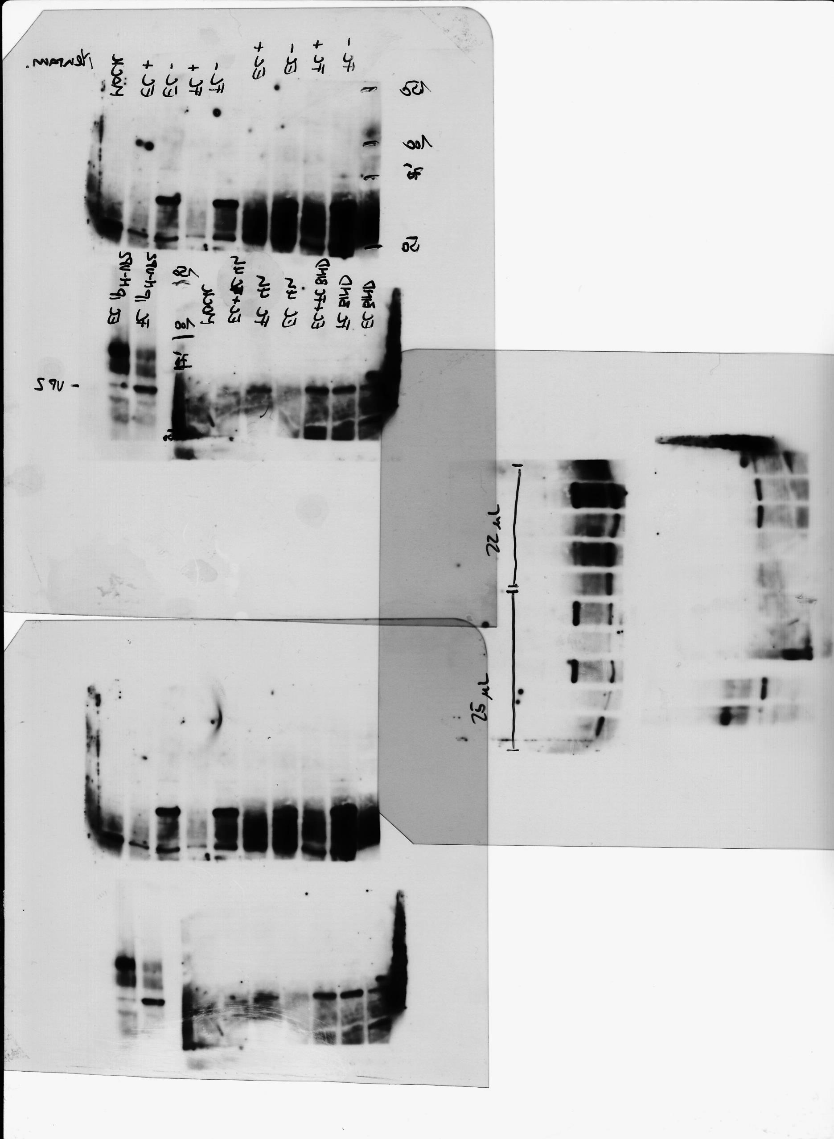
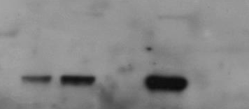
Purification of FC and EC
1 2 3 4 5 6 7 8 9 10 11 12 13 14 15 16 17 18 19 20 21 22 23 24
Empty Capsids
Full Capsids
FC IP^{B7}
EC IP^{B7}
FC IP^{N-VP2}
EC IP^{N-VP2}
FC EC FC EC
- - + + Cht
VP1
VP1
VP2
VP2
VP3
EC and FC bind sialic acids
EC
5
FC
5
FC
5
EC
25
EC
25
MOI
Neur
-
-
+
-
+
VP1
VP2

Slide 3
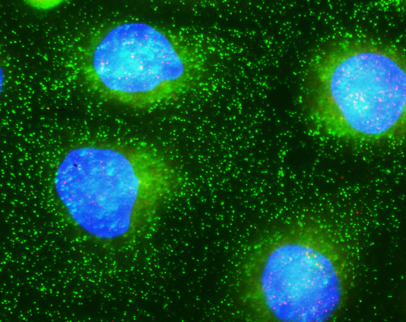
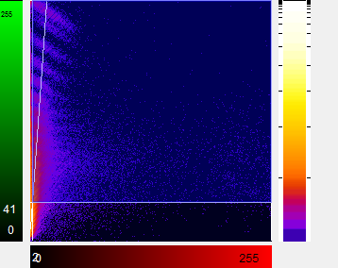
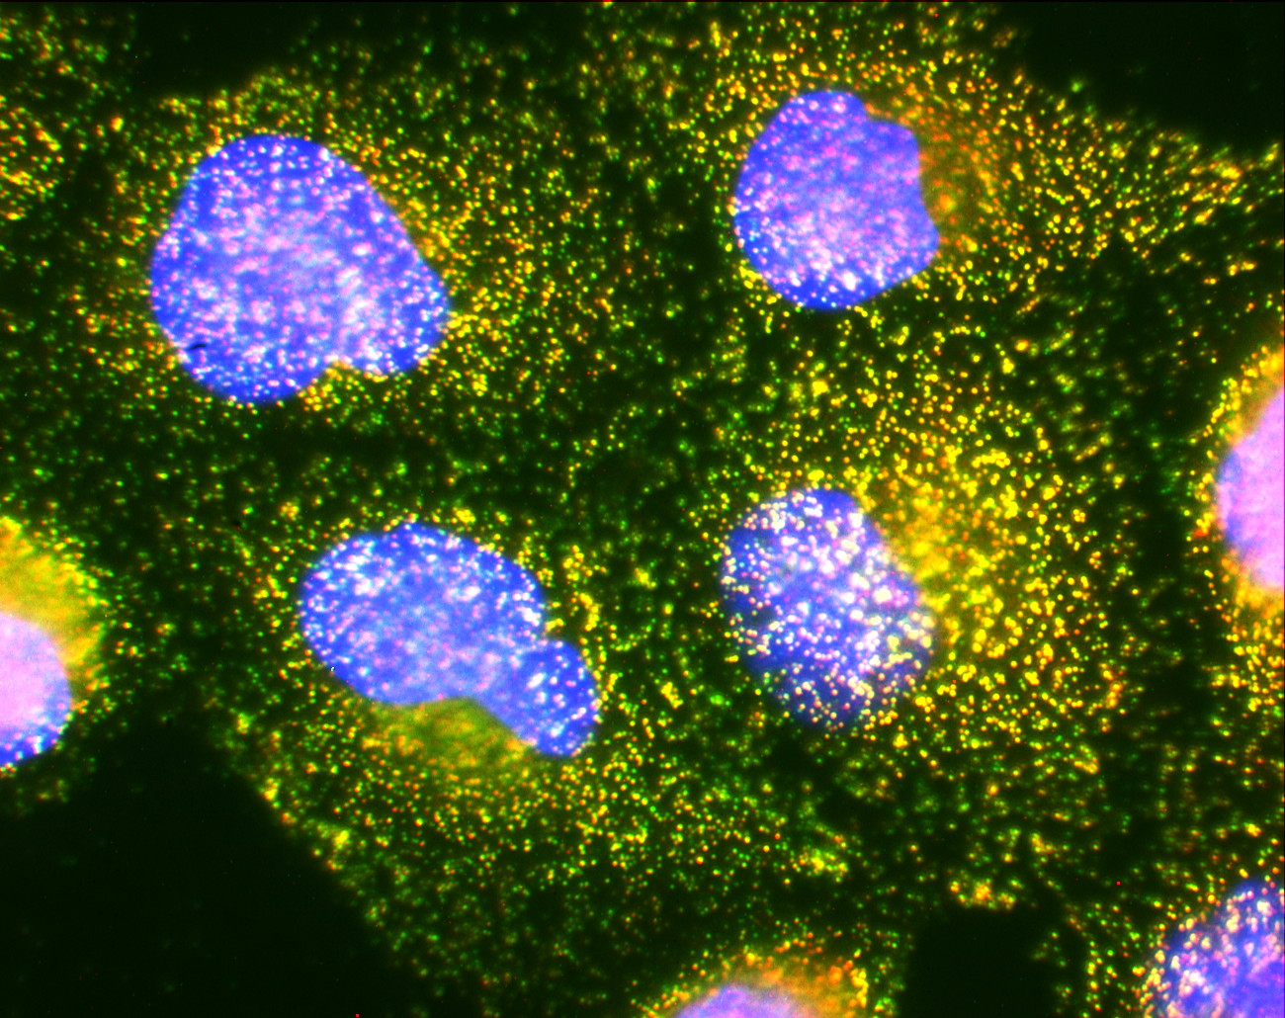
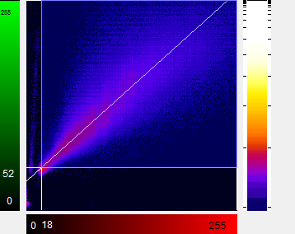
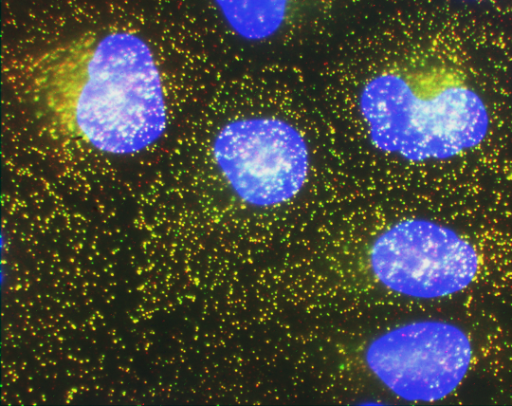
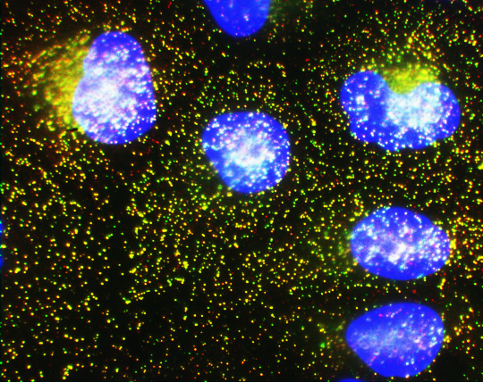
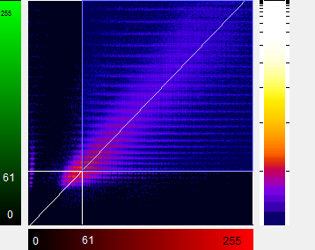
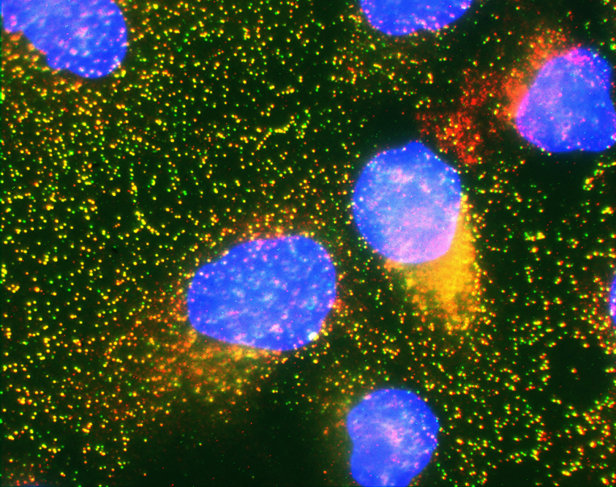
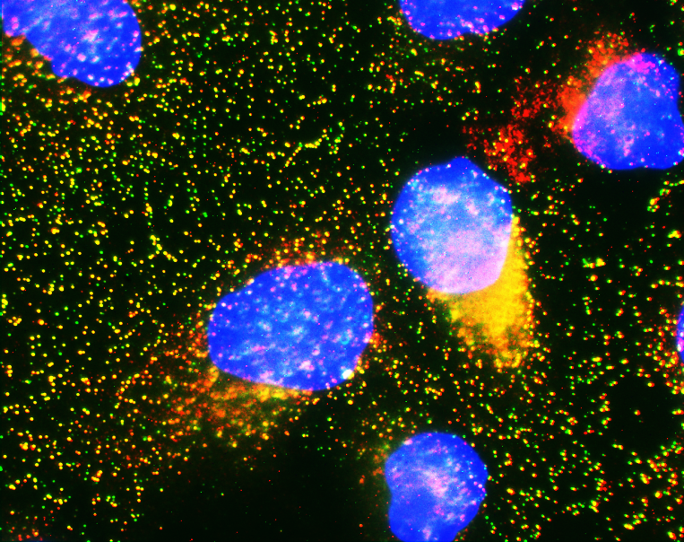
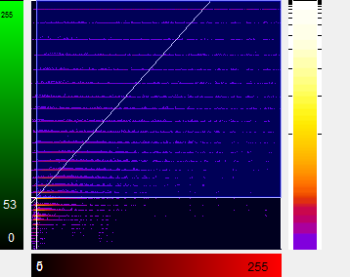
FC has priority over EC (higher affinity for SA)
Binding
Amplification
Scatter Plot
EC
FC
EC + FC
EC(30’) + FC

Slide 5

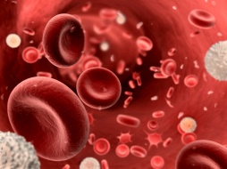
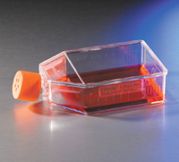
A
B
B19V
CPV
Bone marrow:
Site of production
Blood:
Mature virions
Cell culture:
Pre-mature and mature virions are not seperated
C
D
E
F
B19V purified from plasma
B19V binding
B19V internalization
CPV SN + Cell

